Slide 2
GOOD MORNING

Slide 3
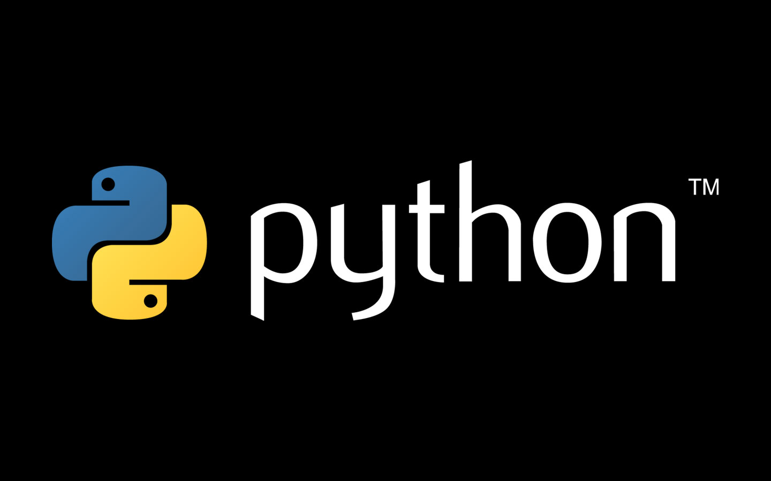

Slide 4
Who am I?
Abhiram R
Senior Developer @ Blue Jeans Network

Slide 5
WHY ANOTHER PROGRAMMING LANGUAGE?

Slide 6
Less pre-work and ease of shipping
Built-in data structures - tuples (immutable arrays), lists (resizable arrays) and dictionaries (hash tables).
Vast applications (sometimes much more preferred than others)
Extensive standard Library (regex, Math, Network etc)
Great beginner language
COMMUNITY!!

Slide 7
Hisstory of Python
Implementation began in Dec 1989
Python 1.0 - January 1994
Python 2.0 - October 16, 2000
Python 2.5 - September 19, 2006
Python 2.6 - October 1, 2008
Python 2.7 - July 3, 2010
Python 3.0 - December 3, 2008 …
Python 3.6 – December 23, 2016 https://pythonclock.org/
Notes:
https://vimeo.com/1093745 – Swarm history

Slide 8
Python Installation
Windows –
https://www.python.org/downloads/windows/
Download 32-bit or 64-bit and Install.
Add C:\Python27\bin to your $PATH variable
Linux /Mac
Ubuntu , Fedora and OSX all come with Python pre-installed .
3.x will need to be installed separately.

Slide 9
Syntax
No braces
Indentation (spaces or tabs)
Maintain consistency!
Blocks

Slide 10
Variables
Strong, dynamic typing
a=5
a=“welcome!” ← NOT FOLLOWING PEP-8
a = 5
a = “Welcome!”
b = “6”
c = 6
a + b ✓
a + c ✗

Slide 11
Variables
c = “5”
d = int(a)
print c,d
print type(c) , type(d)
j = None

Slide 12
Arithmetic and relational operators
k, j = 4, 6
k*j
k+j
k-j
k**j
k<j
k == j

Slide 13
Conditional statements
if a == b: print “Equal!” elif a < b: print “Lesser!” else: print “Greater!”

Slide 14
Loops
For: - for i in range(2,11): print i - for i in range(1,11,2): print i
While: a = 1 while a < 10: print a a = a + 1

Slide 15
Lists
Arrays
a = []
a = [1,2,3,4,5]
b = [“Apple”, ”Carrot”, ”Radish”]
a+b
a[1]
for i in a: print i
for i in range(len(a)): print a[i]

Slide 16
List operations
append
count
extend (+=)
del – Removes item at specific index
remove – Removes the first occurrence of an item
pop
index
reverse
len

Slide 17
Dictionaries
Key-value pairs
dictI = {“1”:”Harry”, “2”:”Ron”, “3”:”Hermione”}
dictI[“2”]
dictI[“2”] = “New”
for name in dictI.keys(): val= dictI[name] print name, "has value =", val

Slide 18
Slicing
a = “Abhiram”
a[:1]
a[:-2]
a[-2:]
a[::-1]
a[:]

Slide 19
Functions
def hello(overload=None): print overload print "1”
hello()
hello(“Something”)

Slide 20
String functions
capitalize
len
lower
upper
strip([chars])
split(’delimiter’)

Slide 21
List comprehensions
li = [ x for x in range(11)]
words = 'The quick brown fox jumps over the lazy dog'.split()
stuff = [[w.upper(), w.lower(), len(w)] for w in words]
for i in stuff: print i

Slide 22
Resources & Contact
Jeff Knupp
Stack Overflow (tag – python)
ProjectEuler
These slides and the iPython notebook are up on – https://github.com/abhiii5459/Talks/tree/master/April_2017/Devopedia_Apr22
__abhiram__ on Twitter
abhiii5459 on Github

